Slide 1
Working with layout and Responsive Web Design04
Session 5
(slot 8-9)

Slide 2
Contents
Web layout using DIV,SPAN
Web layout using table
Create your own responsive design

Slide 3
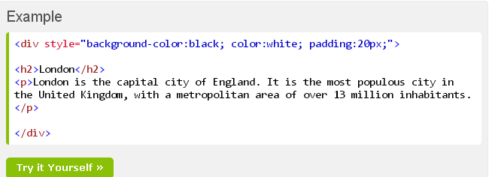
Div element
<div> element is a block level element that can be used as a container for other HTML elements.

Slide 4
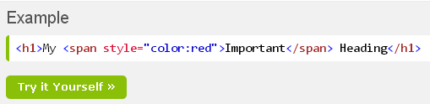
Span element
The HTML <span> element is an inline element that can be used as a container for text.

Slide 5
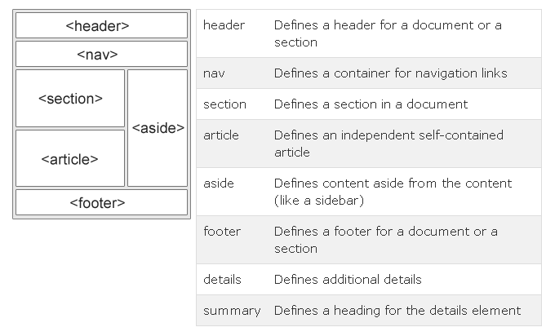
HTML layout
Websites often display content in multiple columns (like a magazine or newspaper).
Notes:
Nav: menu
Section: nội dung
Article: tin lien quan
Aside: quang cao
Footer: bản quền

Slide 6
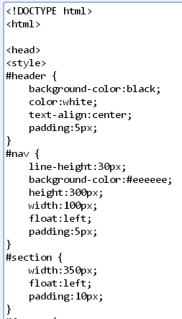
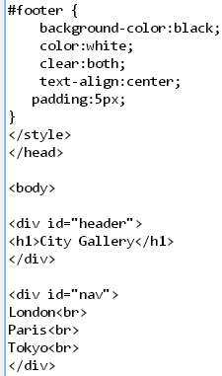
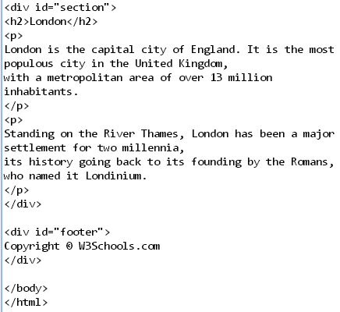
Using div tag

Slide 7
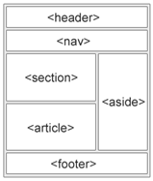
HTML layout using table
Ex: 4 rows, 1 column
At this row, insert a table has 2 rows , 2 cols
Rowspan=2

Slide 8
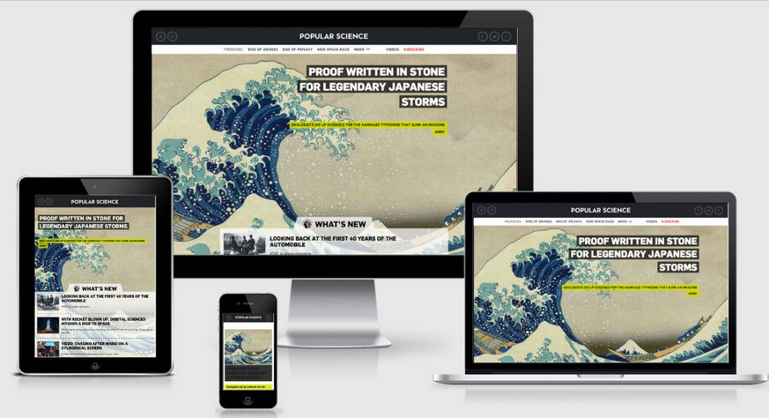
HTML Responsive Web Design
RWD stands for Responsive Web Design
RWD can deliver web pages in variable sizes
RWD is a must for tablets and mobile devices

Slide 9
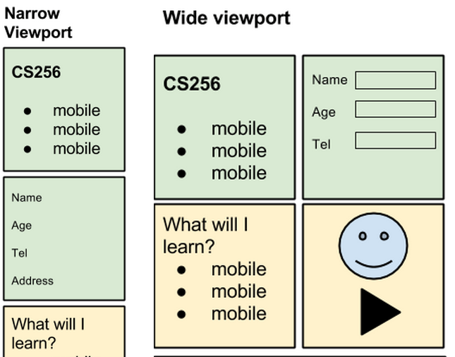

Create your page structure

Slide 10
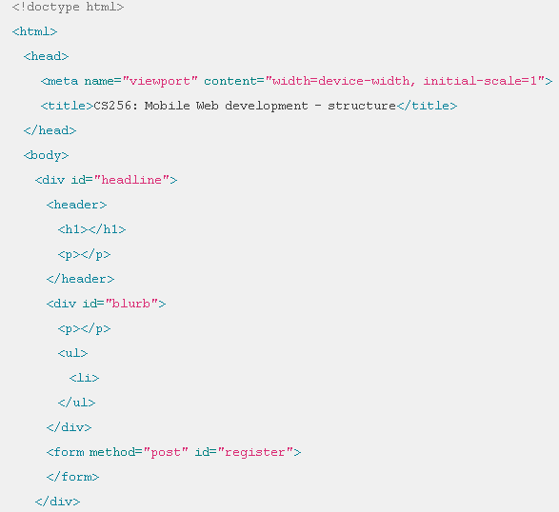
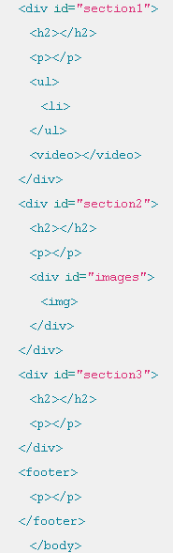

Slide 11
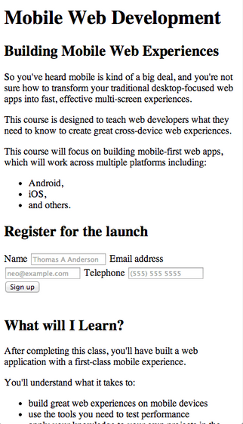
Add content to the page
Insert into header tag
Insert into div id=“blurb tag
Insert into ul tag
Insert into form tag
Insert into div id=“session1” tag
Insert anything into sesion2, session3, footer tag

Slide 12
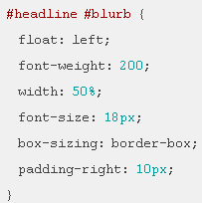
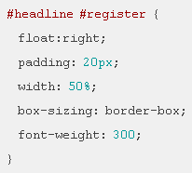
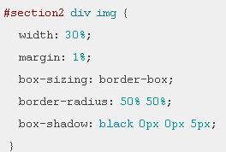
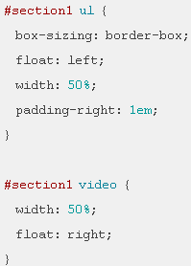

Make It Responsive
Add a viewport
Apply simple styling

Slide 13
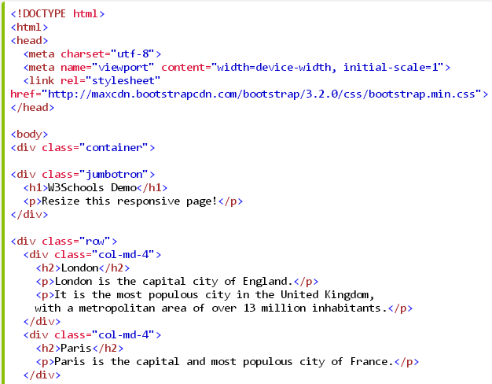
Using bootstrap
use an already existing CSS framework.

Slide 14
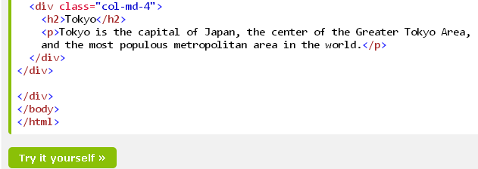
Using bootstrap

Slide 15
summary
A webpage layout is very important to give better look to your website
Responsive web design (RWD) is an approach to web design aimed at crafting sites to provide an optimal viewing across a wide range of devices

Slide 16
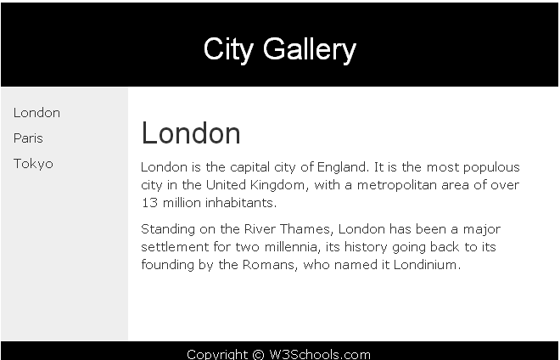
exercise

